Slide 1

Probability theory and statistical analysis: a review
Modeling Uncertainty in the Earth Sciences
Jef Caers
Stanford University

Slide 2
Concepts assumed known
Histograms, mean, median, spread, quantiles
Probability, conditional probability, Gaussian distribution, Random variable, probability density, cumulative distribution
Expectation, variance
Scatterplot, correlation coefficient

Slide 3
Concepts in statistics
Probability, Statistics: a review

Slide 4
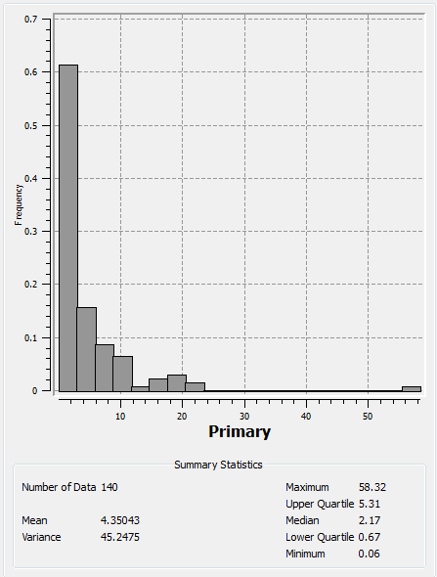
Graphical analysis
But what if we need to compare two data sets and have only very few sample values?

Slide 5
Quantile-quantile plot
a p-quantile with p  [0,1] (a percentile) is defined as that value such that a proportion of 100 × p of the data does not exceed this value
Dataset 1 34 21 8 7 10 15
Dataset 2 16 22 5 9 11 37
Rank-order
Dataset 1 7 8 10 15 21 34
Dataset 2 5 9 11 16 22 37
Percentile 1/6 2/6 3/6 4/6 5/6 6/6

Slide 6
Plotting
Dataset 2
Dataset 1

Slide 7
Concepts in probability theory
Probability, Statistics: a review

Slide 8
Probability
“There is a 60% probability/chance of finding iron ore in this region”
Interpretation 1: The geologist feels that, over the long run, in 60% of similar regions that he studies, one will actually yield iron ore.
Interpretation 2: The geologist assesses, based and his/her expertise and prior knowledge that it is more likely that the region will contain iron ore. In fact, 60/100 is a quantitative measure of the geologist’s assessment about the hypothesis that the region will contain iron ore, where 0/100 means there is certainly no iron ore and 100/100 means there is certainly iron ore.

Slide 9
Conditional probability
S
E
F

Slide 10
Bayes’ rule
Posterior
Likelihood
Prior
“Learning from data” (and hoping to reduce uncertainty)
How much we learn depends on
P(E) : how we knew before we had the data
P(E|F): the (uncertain) relationship between data and the unknown

Slide 11
Example
1/10 of all diamond deposits being considered for appraisal are economical
Garnet is a mineral that tends to co-occur with diamond: in fact, historically:
the probability of garnet exceeding 5ppm for profitable deposits is 4/5 and only 2/5 for non-profitable deposits
Your analysis of garnet data for the current deposit reveals that the garnet content equal 6.5 ppm
What is the probability that the deposit is profitable?

Slide 12
Result
E₁ = “the deposit is profitable”
F₁ = “the garnet content exceeds 6.5ppm”

Slide 13
Random variable
A random variable Z: random variable is a variable whose outcome is unknown but its frequency of outcome is quantified by a probability distribution model
Discrete RVs
Probability mass function (pmf)
Cumulative distribution function (cdf)
Continuous RVs
Probability density function (pdf)
Cumulative distribution function (cdf)

Slide 14
Probability mass function
Notation p_{X}(a) = P(X=a)
For continuous variables p_{X}(a) = P(X=a) = always zero !

Slide 15
Probability density function

Slide 16
Likelihood

Slide 17
Cumulative distribution function
F_{X}(x) = P(X ≤ x)

Slide 18
Examples
Poisson
f_{X}(x)
F_{X}(x)
1
Uniform
x
x
a
b
a
b

Slide 19
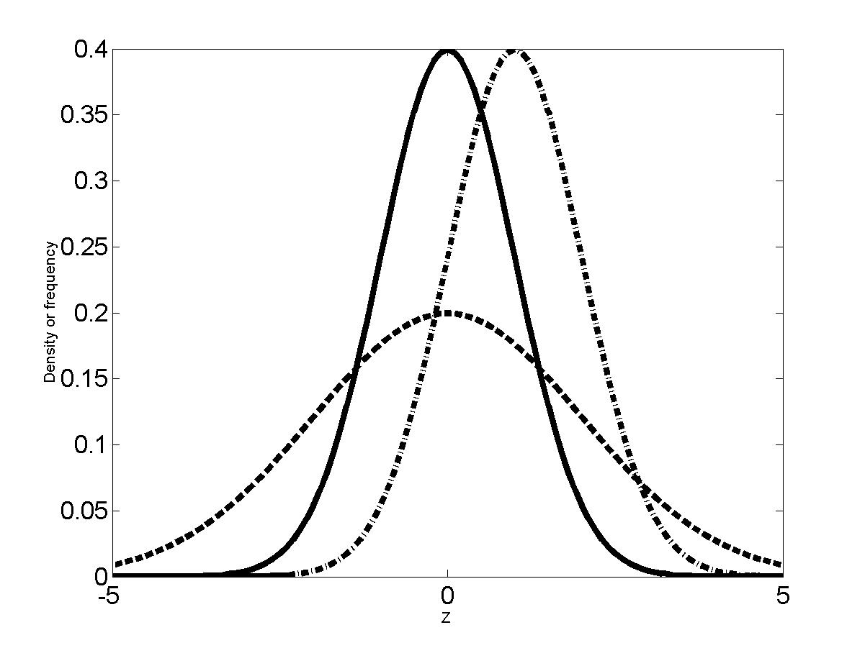
Examples
f_{X}
μ=0,σ=1
μ=1,σ=1
μ=0,σ=2

Slide 20
Empirical distribution function

Slide 21
Modeling from data

Slide 22
Monte Carlo simulation
Aim
Mimicking the process of actual sampling
Needed: Pseudo random number generator
A computer software program that creates (deterministically) a set of uniform random numbers between [0,1], as initiated with a “seed” (a large odd integer such as 56781)
Example: 0.10135, 0.58382, 0.98182, 0.0534 etc…
Other terminology: drawing, sampling

Slide 23
Mechanism

Slide 24
Some first “models of uncertainty”
Samples drawn by Monte Carlo simulation
are a valid model of uncertainty

Slide 25
Data Transformation
Aim
To transform the empirical distribution of a dataset into another empirical distribution
Why?
Certain methods require that the empirical data has a certain shape, such as a standard normal shape
To lessen the influence of extreme values for skewed distributions

Slide 26
Mechanism

Slide 27
Correlation or association

Slide 28
(linear) correlation coefficient
If |r| larger stronger correlation
If r > 0 positive correlation
If r < 0 negative correlation
If |r| = 1 perfect linear correlation
If r = 0 no linear correlation
the range of r restricted to [-1,1]

Slide 29
Examples

